Slide 1
Impact of COVID-19 on ABC Company Parcel Business
190,719
Total records
Weekly customer shipment rows
Step-by-step analysis of parcel volume, customer behavior, peak season performance and business impact
1,061
Customers analyzed
Unique FakeCustomerID values
A PROJECT WORK BY
:
SAMUEL ESSIEN
NNAEMKEA CHARLES ADIBE
2018–2021
Years covered
Pre-COVID, COVID, and normalization period
1 / 16
Notes:
Opening: This presentation explains how COVID-19 changed ABC Company's parcel business. The story moves from the baseline, to the timing of the impact, to peak season, then to customer segment behavior and business implications.

Slide 2
Executive Dashboard & Overview
COVID Parcel Business Analysis
Big Picture: COVID created a clear demand shock
volume surged, peak season intensified and customer behaviour shifted toward high growth.
190,719
1,061
+39.1%
Week 12
+26.5%
11.4%
records
customers
2020 volume
impact starts
peak season
ISGR baseline
Weekly shipment rows
Customer-level analysis
Growth vs 2019
Sustained divergence
2020 vs 2019 peak
Normal-growth benchmark
Overview of the analysis
Executive reading of results
- Compare pre-COVID baseline with COVID-period parcel volume.
- Identify when 2020 weekly volume began to separate from 2019.
- Measure peak-season change and operational pressure.
- Segment customers by size and classify growth, stability, decline and loss.
- Estimate revenue impact using volume as the key driver.
52.9M
Total Revenue
2019 Volume
2020 Volume
73.5M
2019 Revenue
940.3M
Peak 2019
15.4M
2020 Revenue
1,309.5M
Peak 2020
19.4M
+39.3%
Decision Focus: Capacity Planning + Customer Retention
Headline growth
Customer action
2020 volume rose sharply above normal baseline.
High-growth accounts should guide retention and
capacity planning.
I Executive summary: dataset, baseline, COVID impact, customer behaviour and business implication.
2 / 16

Slide 3
Objective
This analysis examines the impact of COVID-19 on ABC Company’s parcel delivery business.
We aim to:
Evaluate changes in parcel volumes before and during COVID-19
Identify when the impact began
Analyze peak season performance
Identity how revenue was impacted
Assess customer growth and behavior across customer segments.
3 / 16
Impact of COVID-19 on ABC Company Parcel Business

Slide 4
Dataset overview and analytical scope
Weekly parcel shipments by customer, year, week, and volume.
190,719
1,061
2018–2021
640,590
Rows
Unique customers
Time coverage
Max weekly volume
Granular weekly records
Customer-level tracking
Before, during, after COVID
Largest row volume
Fields used in this analysis
FakeCustomerID
THE_YEAR
THE_WEEK
VOLUME
Analysis period split: Pre-COVID baseline, COVID observation period, peak season, and post-2020 normalization.
Key takeaway: The dataset supports robust trend and segmentation analysis, but it does not include a direct revenue column.
4 / 16
Impact of COVID-19 on ABC Company Parcel Business
Notes:
The dataset has four columns: customer ID, year, week, and volume. It is strong for shipment-volume analysis. Because revenue is not directly provided, the deck treats parcel volume as a revenue proxy and avoids unsupported claims about actual dollars.

Slide 5
Annual parcel volume: 2020 is the major inflection point
Volumes surged in 2020, then normalized in 2021.
Year-over-year change
+7.6%
2019 vs 2018
+39.1%
2020 vs 2019
Interpretation: 2020 shows a structural demand shock consistent with COVID-driven e-commerce and delivery demand. The 2021 decline suggests normalization after the peak..
Key takeaway: 2020 volume was 73.5M parcels, up 39.1% from 2019.
5 / 16
Impact of COVID-19 on ABC Company Parcel Business
Notes:
This is the core annual result. Parcel volume rose from 52.8M in 2019 to 73.5M in 2020. The decline in 2021 should be framed as normalization rather than necessarily weakness, because 2020 was exceptional.

Slide 6
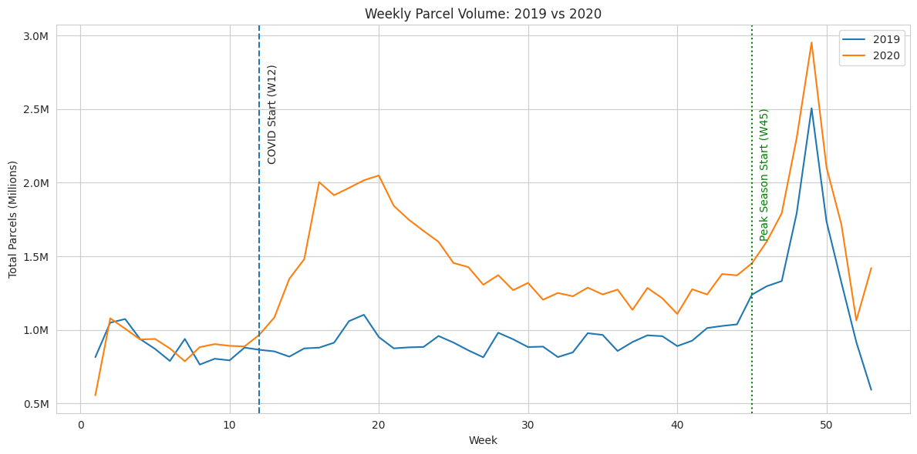
Weekly trend: the COVID impact begins around Week 12
The divergence between 2019 and 2020 becomes clear after the lockdown period.
Evidence around onset
W12
+11.9%
COVID onset marker
W14
+64.6%
Sharp acceleration
W16
+127.9%
Largest early divergence
W20
+115.4%
Demand remained elevated
Key takeaway: After Week 12, 2020 volumes stay consistently above 2019, signaling a sustained behavioral shift.
6 / 16
Impact of COVID-19 on ABC Company Parcel Business
Notes:
Week 12 is used as the COVID observation starting point. The line chart shows that the 2020 line pulls away from 2019 immediately after the onset. Week 16 is especially strong, with volumes more than double the same week in 2019.

Slide 7
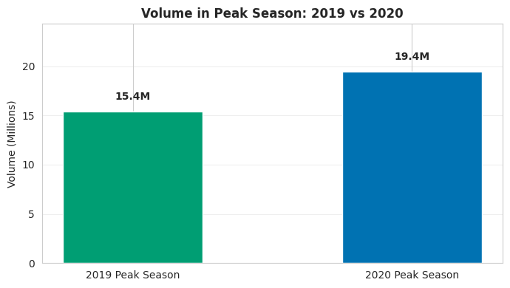
Peak season: 2020 outperformed 2019 by 26.5%
Holiday-season parcel demand intensified during the pandemic year.
15.4M
2019 peak season
Weeks 45–53 plus following weeks 1–3
4.1M
19.4M
2020 peak season
Same cross-year peak-window definition
+26.5%
Peak season change
Extra 4.1M parcels vs 2019 peak
Key takeaway: COVID amplified the already-critical peak season, creating higher operational pressure and capacity requirements.
7 / 16
Impact of COVID-19 on ABC Company Parcel Business
Notes:
Peak season increased from 15.4M to 19.4M parcels. This means the business had to handle about 4.1M more parcels during its most operationally sensitive window.

Slide 8
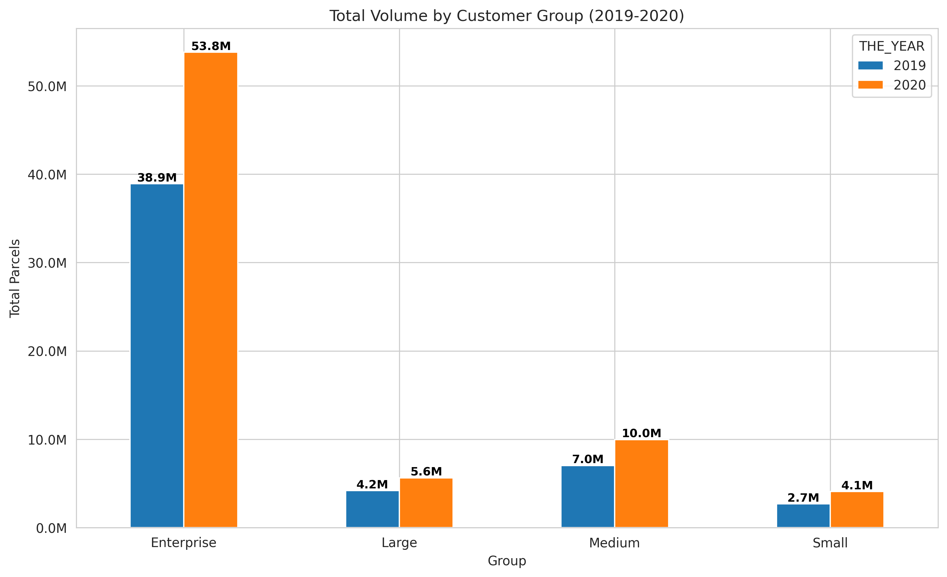
Impact by customer group: Enterprise dominates volume
All groups increased in 2020, but the volume base remains concentrated.
Segment interpretation
Enterprise
Largest total volume and the biggest absolute swing.
Large
Small customer count, but important growth signal.
Medium
Meaningful contribution and a clear 2020 uplift.
Small
Lower volume individually, but broad base and high variability.
Key takeaway: COVID created a broad uplift, but operational risk is concentrated in high-volume Enterprise accounts.
8 / 16
Impact of COVID-19 on ABC Company Parcel Business
Notes:
Enterprise customers represent a small number of accounts but dominate parcel volume. The 2020 uplift appears across segments, which supports the interpretation that this was a structural market shock rather than a single-customer anomaly.

Slide 9
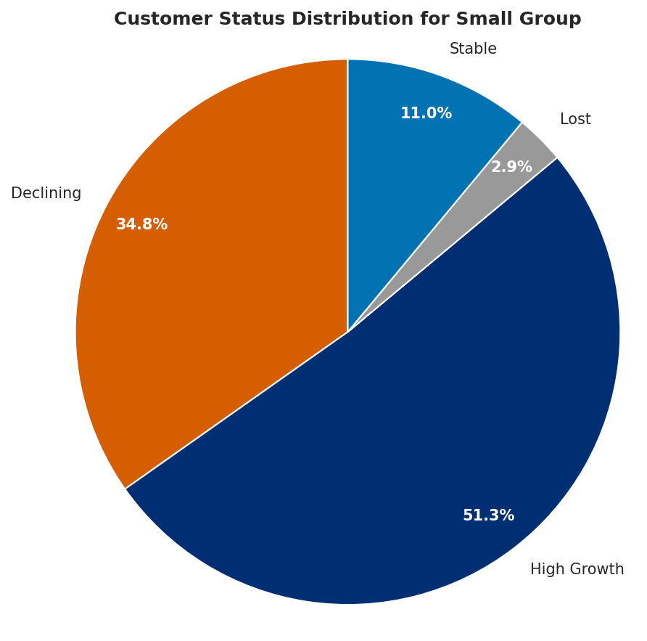
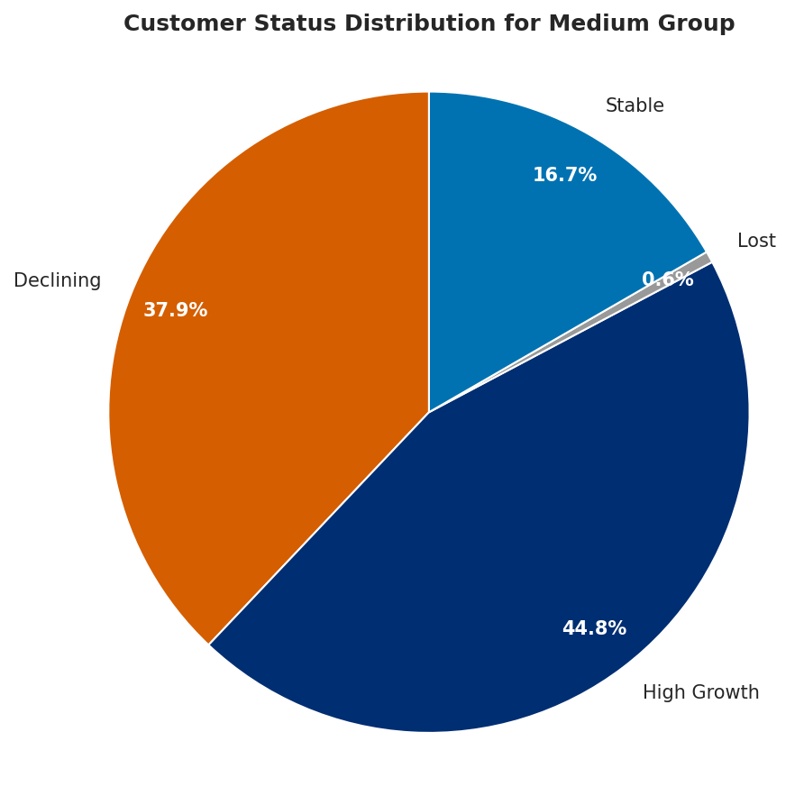
Customer segmentation 1: customer mix shifted in 2020
Customers were classified as High Growth, Stable, Declining, or Lost during COVID.
9 / 16
Key takeaway: COVID did not only increase volume; it changed the composition of the customer base.
Notes:
This slide looks at customer count by size group, not total volume. The customer base changed in composition, with more customers showing medium-size behavior in 2020 and some falling into micro/other.

Slide 10
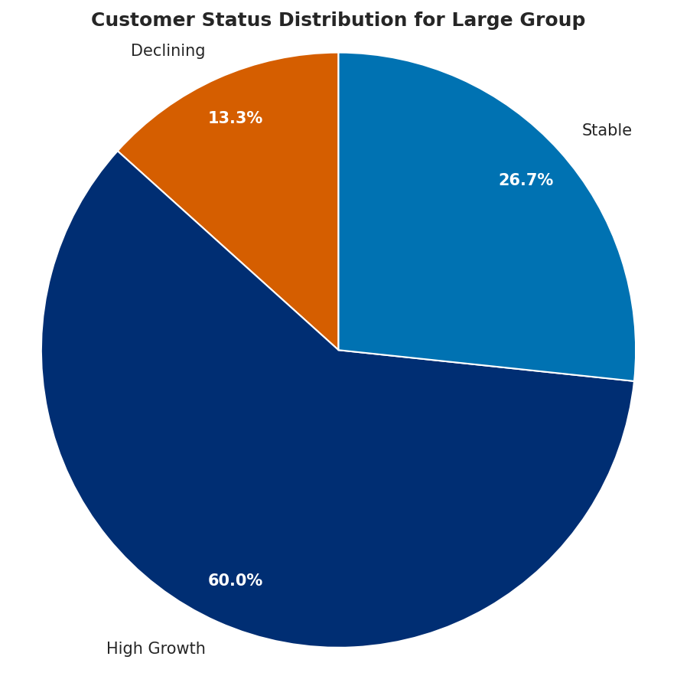
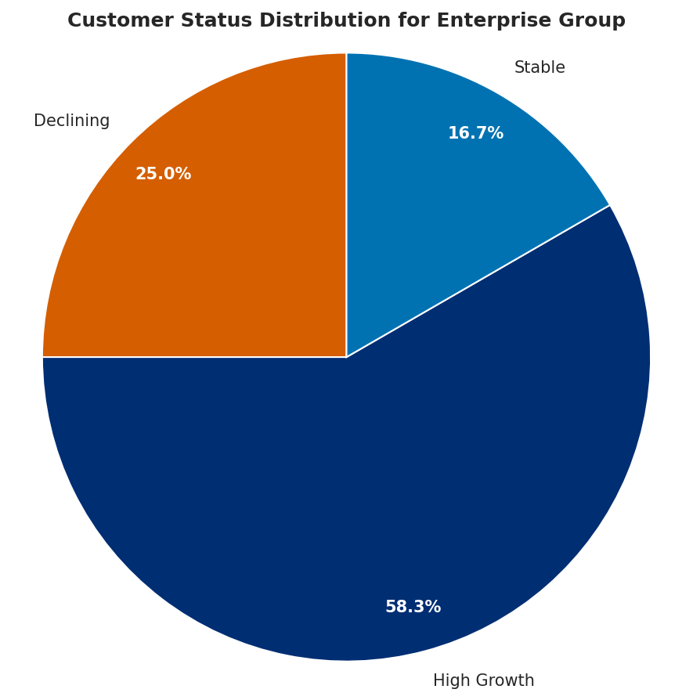
Customer segmentation 2: high growth was the dominant pattern
Key takeaway: Every segment had a majority or near-majority of customers in High Growth, but declining customers still require targeted retention.
10 / 16
Impact of COVID-19 on ABC Company Parcel Business
Notes:
This is the customer-level view. High growth is strongest in the Large and Enterprise segments. However, a substantial share of Medium and Small customers declined, so the business impact was positive overall but uneven across customers.

Slide 11
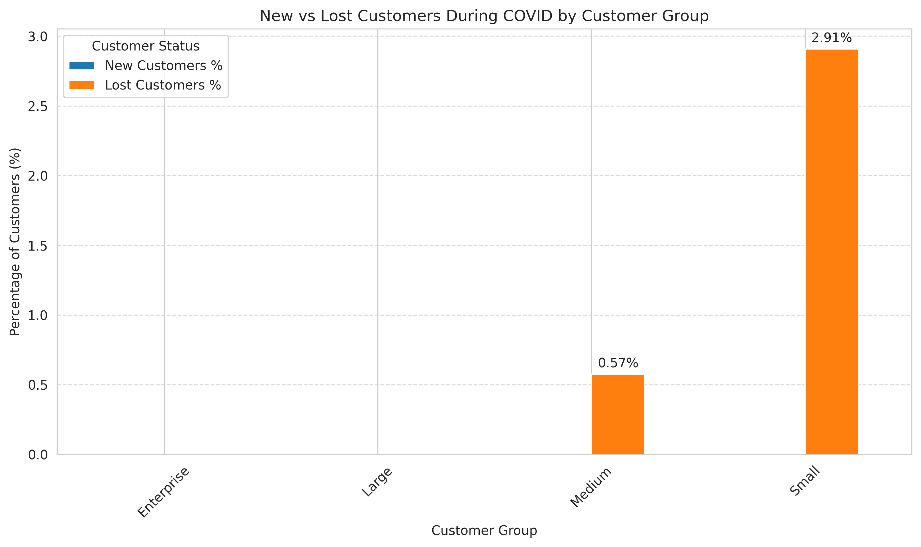
Percentage of new and lost customers
11 / 16
Impact of COVID-19 on ABC Company Parcel Business

Slide 12
Impact of COVID on volume by customer group
12 / 16
Impact of COVID-19 on ABC Company Parcel Business

Slide 13
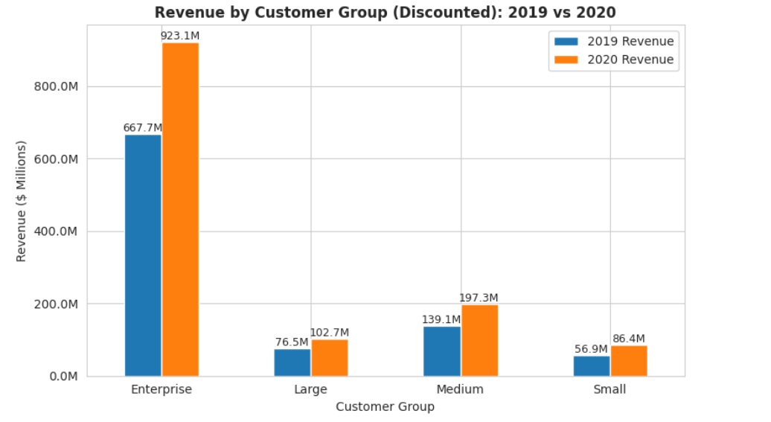
Overall impact of COVID on revenue by customer group
13 / 16
Impact of COVID-19 on ABC Company Parcel Business

Slide 14
Build the normal-growth baseline: ISGR = 11.4%
Early 2019 vs early 2020 is used as the pre-COVID benchmark.
11.4%
Baseline growth rate
Industry Standard Growth Rate
Why this matters
Any customer or segment growing above 11.4% during COVID is treated as likely having pandemic-driven demand beyond normal business expansion.
Key takeaway: The baseline prevents over-attributing normal business growth to COVID.
14 / 16
Impact of COVID-19 on ABC Company Parcel Business
Notes:
The pre-COVID volume increased from 13.1M parcels in early 2019 to 14.6M in early 2020, which equals 11.4% growth. That is the threshold used to separate normal growth from likely COVID-driven growth.

Slide 15
Business answers
COVID impact began around Week 12 (March 2020)
Driven by lockdowns and e-commerce growth
Peak season increased by 26.5%
Majority of customers experienced high growth
Revenue increased due to higher parcel volume
15 / 16
Impact of COVID-19 on ABC Company Parcel Business

Slide 16
Conclusion: COVID created a structural demand shock
The evidence is consistent across annual volume, weekly onset, peak season, and customer status.
Main findings:
+39.1%
Week 12
Bottom line
2020 volume growth vs 2019
Timing of sustained divergence
ABC Company should treat the 2020 surge as more than a temporary spike: it reveals customer behavior changes, capacity stress points, and account-level growth opportunities that can guide future planning.
+26.5%
High Growth
week 45 Peak season growth in 2020
Dominant status across customer segments
Thank you
Key takeaway: Strong volume growth is the headline; customer segmentation is the path to action.
16 / 16
Impact of COVID-19 on ABC Company Parcel Business
Notes:
Close by emphasizing the integrated story: the annual spike identifies the scale, the weekly chart identifies the timing, peak season shows operational impact, and customer status shows where to target retention and growth.

